Slide 1
Gulag, WWII and the long-run patterns of Soviet city growth
Tatiana Mikhailova
MSSE, September 2012

Slide 3
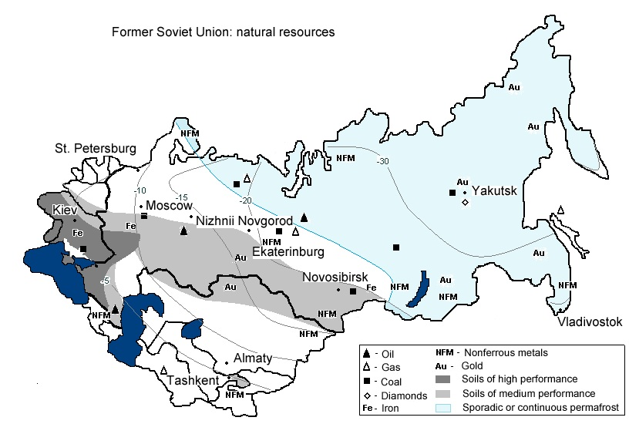

Slide 4
Questions: history of Soviet city growth
Wartime evacuation of industry = driver of city growth?
Decline of the western regions: war destruction or policy?
Shift of population center: 1926-1959 → east, 1959-1970 ←
Role of GULAG and forced migrations
Kulaks (1920s-1930s) – rural-to-urban migration, deportations to (sub)urban and rural location
Ethnic deportations (1940s) – rural destinations
GULAG camps – source of labor where it was scarce
urban and rural locations
This paper: city-level data + new data on GULAG and evacuation

Slide 5
Questions: spatial structure of the economy
Exogenous shocks: are they permanent or temporary?
Natural experiments: Davis & Weinstein, 2002 (+ others); Redding, Sturm, Wolf, 2007; Redding & Sturm, 2008
Wartime destruction does not alter spatial economy in long run
Changes in market access do
USSR – a different type of natural experiment
don’t destroy, create (agglomeration externalities)

Slide 6
Experiment of Soviet location policy: not exogenous
Soviet locational principles -Rodgers (1974)
be close to raw materials, minimize transport costs
equalization of regional development
defense
“…enhancement of the Soviet capability for supplying a protracted war of resources was not an accidental by-product of Soviet industrialization, but was a deliberate element in the complex of goals set out in the transition period of 1928-31.”
– M. Harrison (1990), “Stalinist Industrialisation and the Test of War”
What was achieved?
Shift of industry to the east in 1930s? Harrison (1990), Stone(2005): insufficient
WWII evacuation = forced implementation of existing plan

Slide 7
New data - 1
GULAG
“Sistema Ispravitel’no-trudovykh uchrezhdenii…”, Memorial, 1998
Camp location, population, years of operation, type of industry/activity
latitude, longitude
person-years
agriculture&forestry, industry, mining, construction (industrial, primary ind., housing, infrastructure)
Match to cities:
Camps in 20 km, 50 km
Distance to camp

Slide 8
GULAG

Slide 9
GULAG as an urban phenomenon

Slide 10
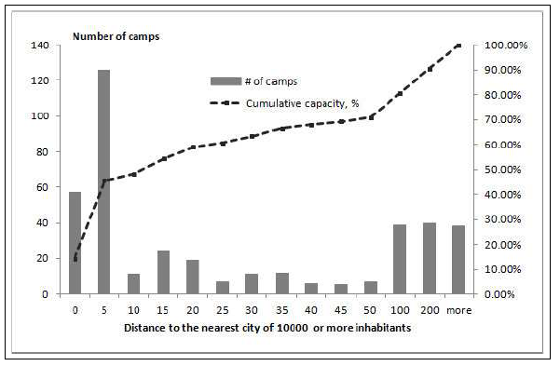
A majority of Gulag cities existed in 1939, some were new

Slide 11
GULAG near large cities

Slide 12
Distance to GULAG and city growth, 1926-1959

Slide 14
New data - 2
Wartime evacuation of industry
“Factories, Research and Design Establishments of the Soviet Defense Industry” database, U Warwick
extract those that moved in 1941-1946 (evacuation and back)
record: city-origin, city-destination, returned/not
Match to cities

Slide 15
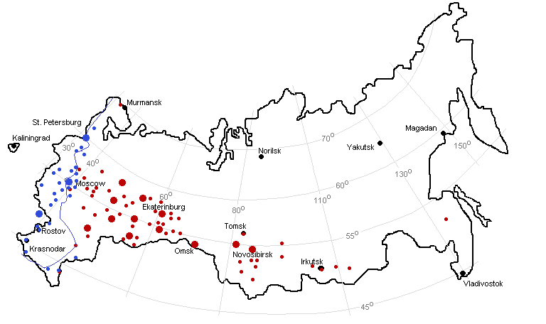
Wartime evacuation

Slide 16
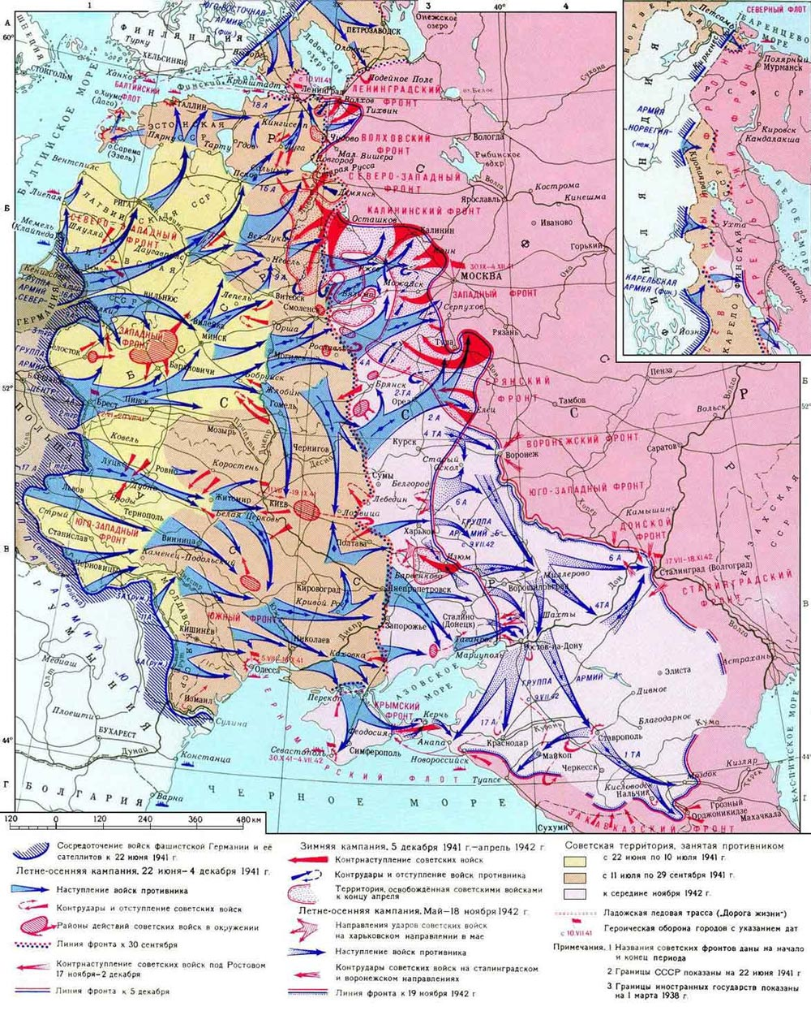
(Not so new) data -3
Cities:
occupied
30 km from front
artillery fire, evacuation
200 km from front
bombing, evacuation

Slide 17
Simple average city size indices

Slide 18
What is the role of policy vs. other factors?
Estimate the effect of treatment, controlling for city characteristics
via individual effects in panel data (observable, unobservable)
explicitly (matching)

Slide 19
Panel estimations
random effects
one treatment at a time
all treatments simultaneously

Slide 20
City size index, as implied by separate panel estimations with city effects.

Slide 23
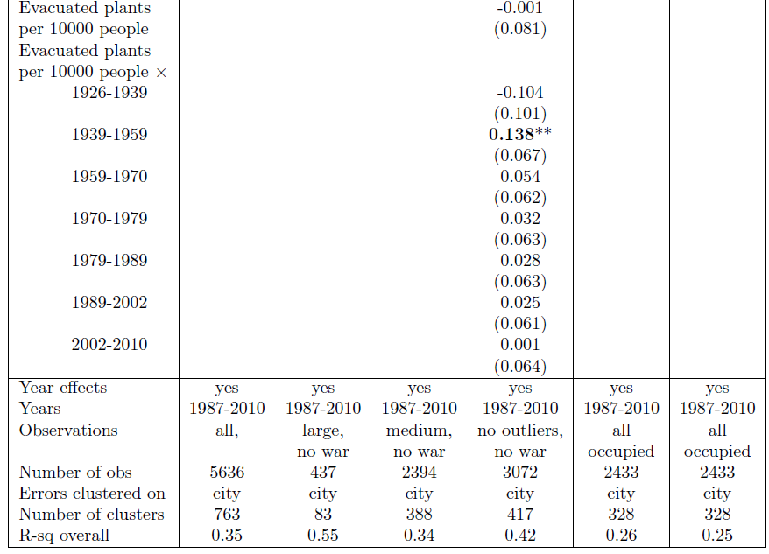
(continued)

Slide 25
City size indices, as implied by a single panel with three treatments

Slide 26
Random effects are not random

Slide 27
Matching
Control for observables explicitly
Match on
pre-treatment population and growth rates
administrative status
geographical location (longitude, latitude)
simultaneous treatments

Slide 28
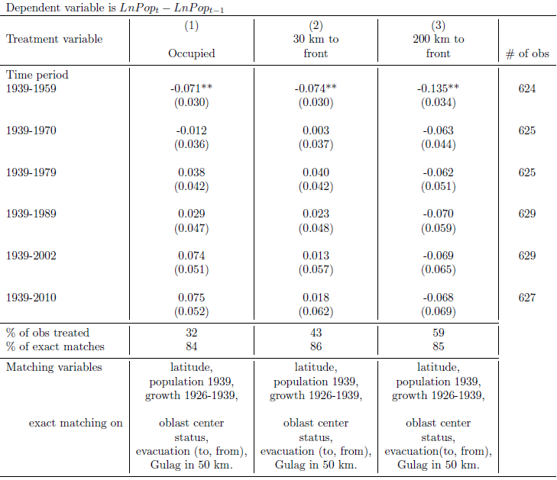
Matching: WWII

Slide 29
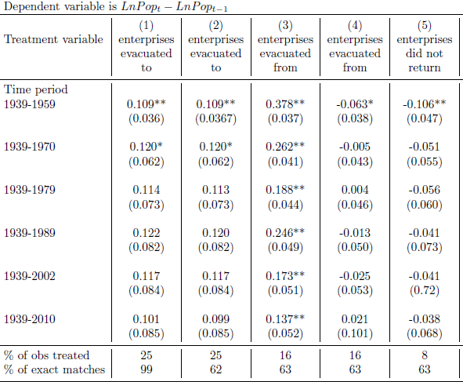
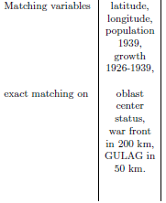
Matching: evacuation
+ Urals,
Siberia
Matching variables:
- longitude

Slide 30
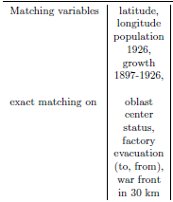
Matching: GULAG

Slide 32
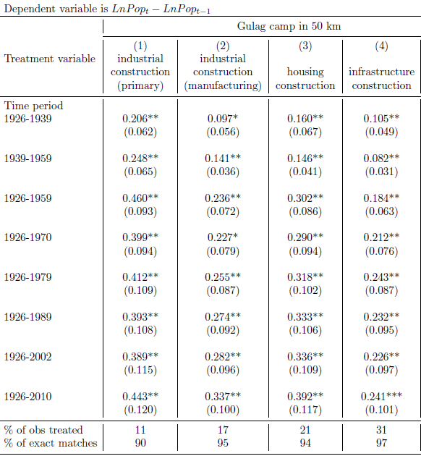
Matching: construction in GULAG

Slide 33
Results:
Effect of WWII, controlling for other factors exists for <30 years
In line with Japan (Davis & Weinstein, 2002), Germany (Brakman at al, 2004), Vietnam (Miguel & Roland, 2011)
Wartime evacuation results in city growth, but significant for < 30 years
heterogeniety, need more research, more data
The effect of GULAG is permanent
stronger for camps that created capital
(Redding, Sturm, Wolf, 2007): “permanent” changes are required to switch equilibria

